Slide 1


Controlling
as a function of management
By
Dr. Raveendra Rao K
Department of Humanities and Management, MIT, MANIPAL

Slide 2


Controlling
Controlling is verifying whether everything occurs in conformity with the plan adopted, the instruction issued and principles established.
It has for object to point out weaknesses and errors in order to rectify them and prevent recurrence.
It appears on everything, things, people, and actions.

Slide 3
















Steps in controlling
Establishment of standards
Actual performance
Measure actual performance
Compare Actual performance vs. Standard
Implementation of corrections
Program of corrective actions
Analysis of causes of deviations
Identification of deviations
5

Slide 4

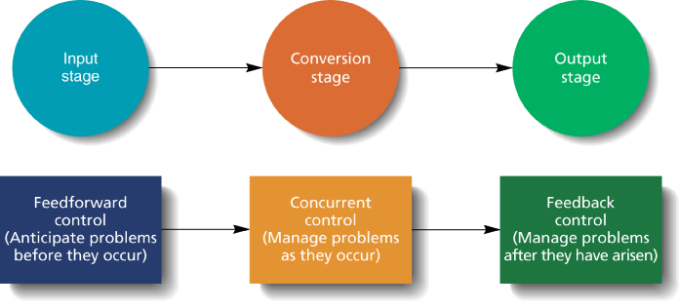
Three types of Control:

Slide 5
Feed forward Controls
  Control that allows managers to anticipate problems before they arise
Concurrent Controls
  Give managers immediate feedback on how efficiently inputs are being transformed into outputs
Feedback Controls
  Control that gives managers information about customers’ reactions to goods and services

Slide 6
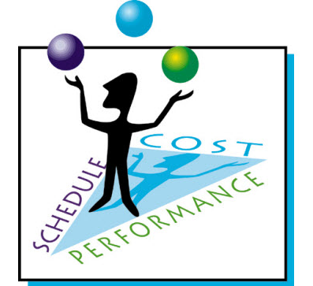
Management control techniques
Classified under three basic categories:
Budgetary controls
Non-budgetary controls
Network techniques

Slide 7
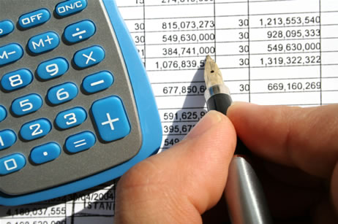
Budgetary Controls
A process of finding out what is being done and comparing the actual results with the budgeted.
This is done in order to approve accomplishments or to remedy differences by adjustment or correction..
Types: Fixed budget, Flexible budget, Master budget, Sales budget, Production budget, Materials budget, Labor budget, Capital expenditure budget.

Slide 8

Non budgetary controls
Cost Control
Internal audit control
External audit control
Break even point analysis

Slide 9

Budget: Definition & Concept
Budget: is a single-use plan that details the resources – usually financial, that will be required to complete a program, project, or other organizational activity.
The report can be viewed by the manager and can take required action.

Slide 10
Types of budgets
Financial Budget | Sources and uses of cash
Cash flow, or cash budget | All sources of cash income or expenditure in monthly, weekly, or daily periods
Capital expenditure budget | Costs of major assets such as plant, machinery, or land
Balance sheet budget | Forecast of the organization’s assets and liabilities in the event all other budgets are met
A financial budget indicates the organization expects to get its cash for the common time period and how it plans to use it.

Slide 11
Types of budgets
Operating Budget | Planned operations in financial matters
Sales or revenue budget | Income the organization expects to receive from normal operations
Expense budget | Anticipated expenses for the organization during the coming time period
Profit budget | Anticipated differences between the sales or revenues and expenses
An operating budget is concerned with planned operations within the organization.

Slide 12
Types of budgets
Non-monetary Budget | Planned operations in non financial terms
Labor budget | Hours of direct labor available for use
Space budget | Square feet of space available for various functions
Production budget | Number of units to be produced during the coming time period
A non-monetary budget is a budget expressed in non financial terms, such as units of outputs, hours of direct labor, machine hours or square foot allocations.

Slide 13
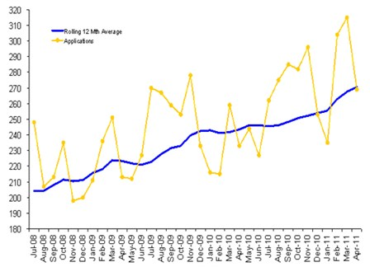
Non-budgetary control devices
There are many traditional control strategies that are not connected with budgets.
Personal observation (Management by walking around)
Statistical data
Special reports and analyses
Operational audit (Internal audit)

Slide 14

Overall control
Controls are designed for specific things: policies, employee selection, training, etc. where we wish the performance to conform the plans.
Such controls apply to a part of enterprise and do not measure total accomplishments against total odds.

Slide 15
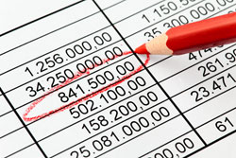
Overall control devices
Budget Summaries & reports
A budget summary is a resume of all the individual budgets, reflects company plans so that sales volume, costs, profits, utilization of capital, and return on investment may be seen in a proper relationship.

Slide 16
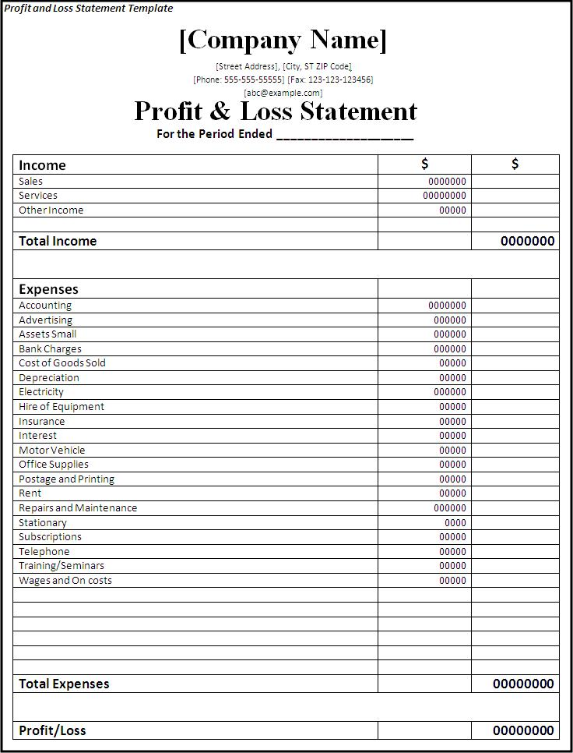
Overall control devices
Profit and loss control
Profit and loss control usually is practicable for only major segments of a company.
Since it is a statement of all revenues and expenses for a given time, it is a true summary of the results of business operations.

Slide 17

Overall control devices
Return on investment
One of the most successfully used control techniques.
Considers profit, not as an absolute item, but as a return on the capital employed in the business.
Focuses on managerial attention on the business- making the best profit possible on the capital available.

Slide 18
Dangers in Budgeting :
Over-budgeting – There is a danger of over-budgeting through spelling out minor expenses in detail and depriving managers of needed freedom in managing their departments.
Over-riding enterprise objectives/goals – Another danger lies in allowing budgetary goals to become more important than enterprise goals. In this zest to keep within budget limits, managers may forget that they owe primarily to enterprise objectives.
Hiding inefficiency – it may be used to hide inefficiencies of managers.
Causing Inflexibility – it is one of the greatest dangers in budgets. flexibility in decisions will be lost due to budgets and decision will become rigid.

Slide 19
Critical Control Points & Standards:
The points selected for control should be critical. The principle of critical point control states that – “Effective control requires attention to those factors critical to evaluating performance against plans”.
Following are the types of Critical Point Standards used:
Physical standards – they are non-monetary measurements and are common at the operating level, where materials are used, labour is employed, services are rendered, and goods are produced.

Slide 20
  They may reflect quantities such as labour hours per unit of output, Kg of fuel per HP power generated, units of production per machine hour etc. it may also reflect quantities such as hardness of bearings, closeness of tolerances, durability of fabrics etc.
Cost standards – cost standards are monetary measurements, and like physical standards, are common at the operating level. They attach monetary values to the costs of operations. It reflects various costs as direct & indirect cost per unit produced, labour cost per unit, material cost per unit, machine hour cost etc.

Slide 21
Capital standards – there are a variety of capital standards, all arising from the application of monetary measurements to physical items. They have to do with the capital invested in the firm rather than with operating costs & are therefore primarily related to balance sheet rather than to income statement.
Most widely used capital standards are Return on Investment (ROI).
The Balance Sheet will disclose other capital standards such as current assets to current liabilities ratio, debt to net worth ratio, fixed investment to total investment ratio, receivables to payables ratio (Both cash & credit), size & turnover of inventories.

Slide 22
Revenue standards – they arise from attaching monetary values to sales. They may include standards such as revenue per bus passenger mile, average sales per salesmen or customer etc.

Slide 23
Program standards – a manager may be assigned to install a variable budget from a program for formally following the development of new products, or a program for improving the quality of a sales force. Although a subjective judgment may have to be applied in appraising program performance, timing & other factors can be used as objective standards.

Slide 24
Intangible standards – More difficult to set these standards since these standards are not expressed either in physical or monetary measurements.
EG:
What can one use for determining whether the advertising program meets both short & long run objectives?
Whether the public relations program is successful?
Are supervisors loyal to the company objectives? etc.
Many intangible standards exist in business. Considerable judgment, trial & error, and even an occasion may be used for setting and using the intangible standards.

Slide 25
Goals as standards – the quantitative goals set by the organization act as standards, since these set goals are tangible and can be suitably used as standards for the purpose of control.
Strategic plans as standards – strategic plans drawn by organizations may also act as standards and used as critical points for strategic control purposes.

Slide 26
Any Questions ???
Thank You

